Slide 1


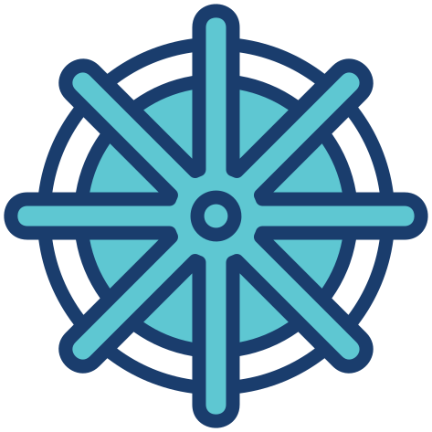
DOCKER & KUBERNETES
Presented Aymeni

Slide 2


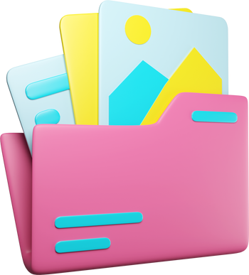
WHO AM I ?
Aymen Boubetana
A second-year student in Information Systems Engineering and Big Data, I am passionate about data engineering and data analytics. I also have experience in web development.
https://www.linkedin.com/in/boubetana-aymen/
https://github.com/AymenBoubetana/
https://boubetana-aymen.netlify.app

Slide 3
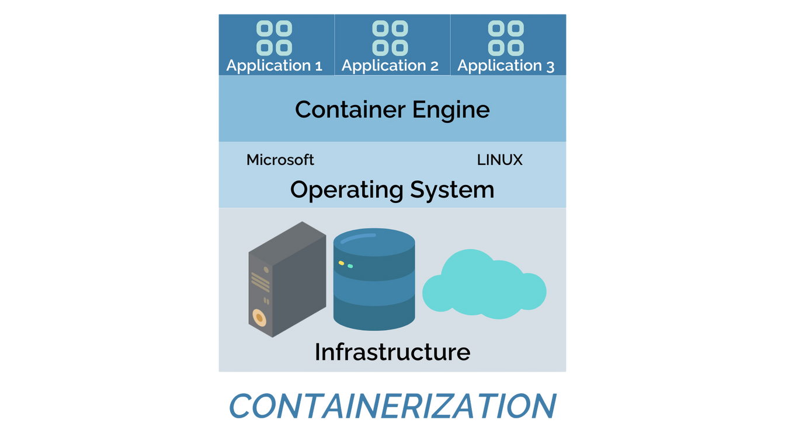
What is Containerization?
Containerization is a technology that allows you to package an application along with all its dependencies, libraries, and configuration files into a single lightweight, portable unit called a container.

Slide 4
Traditional Application Deployment vs. Containerized Deployment
1. Traditional Deployment:
Monolithic Architecture:
Applications were often developed as a single large unit, making them harder to manage and scale.
Dependency Issues:
Applications relied on the environment where they were installed (e.g., OS, libraries, configurations).
Example: "It works on my machine but not on the server!"
Resource Allocation:
Running multiple applications on the same machine often led to conflicts and inefficiencies.

Slide 5
Traditional Application Deployment vs. Containerized Deployment
2. Containerized Deployment:
Applications are broken into smaller services (microservices), each running in its own isolated container.
Containers include everything needed for the application to run, ensuring consistency across environments.
Containers are lightweight, sharing the host OS kernel, making them faster and more resource-efficient than virtual machines.

Slide 6
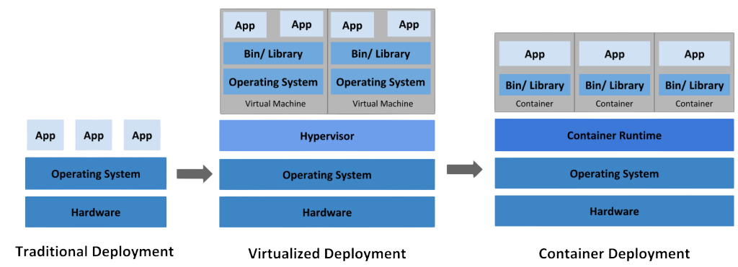
Traditional Application Deployment vs. Containerized Deployment

Slide 7
The Problem Containers Solve
1. Portability:
Containers work consistently across different environments, whether it's a developer's laptop, a testing server, or production.
2. Dependency Isolation:
Each container runs its own dependencies, preventing conflicts between applications on the same host.
3. Scalability and Efficiency:
Containers are faster to spin up and use fewer resources compared to VMs, making them ideal for dynamic scaling.
4. Consistent Development and Deployment:
Developers can focus on building applications without worrying about the underlying infrastructure.

Slide 8
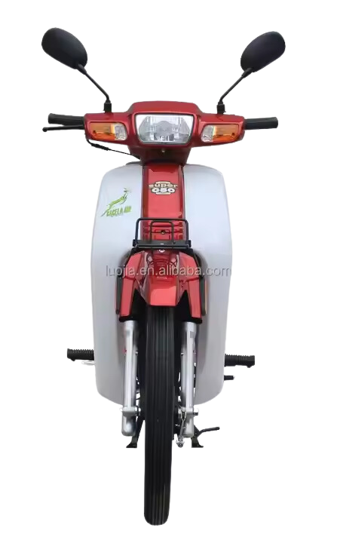

Docker

Slide 9
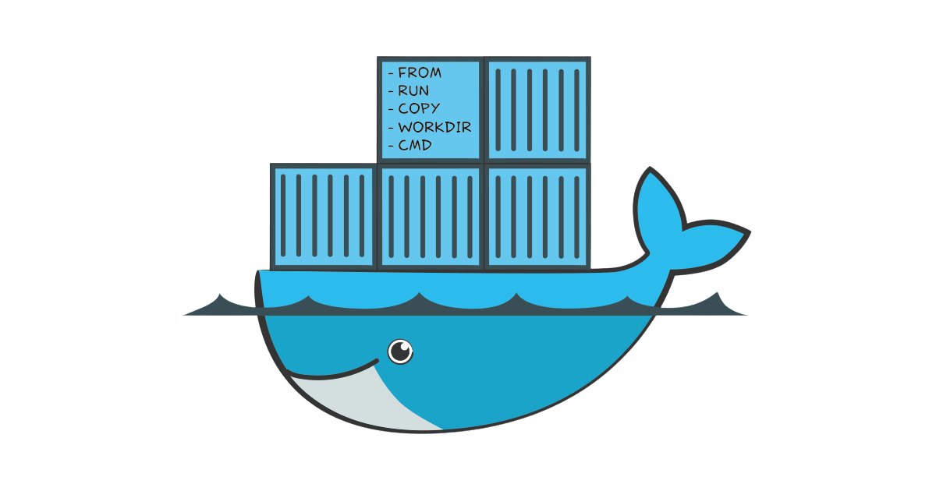
Docker
Docker is an open-source platform that allows developers to build, ship, and run applications in containers. It ensures that applications run consistently across different environments by packaging them with all their dependencies, libraries, and configurations.

Slide 10
Core Concepts
1. What is a Docker Container?
A container is a lightweight, standalone, and executable package that includes everything needed to run an application:
Code
Libraries
Dependencies
Configuration files
Containers provide isolation: Each container runs independently without interfering with other containers on the same system.

Slide 11
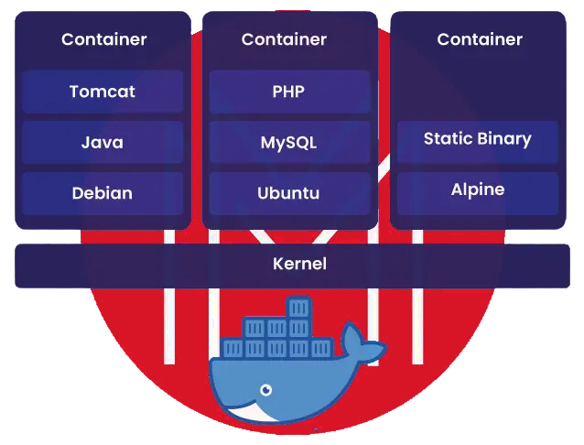
Core Concepts
1. What is a Docker Container?

Slide 12
Core Concepts
2. Docker Images, Dockerfiles, and Registries
Docker Image:
A blueprint for a container.
It’s an immutable snapshot of an application and its environment at a specific point in time.
Dockerfile:
A text file containing a set of instructions to create a Docker image.
Example: Installing software, copying files, and defining entry points.
Docker Registries:
Storage locations for Docker images.
Docker Hub is the default public registry, while private registries can be used for secure or custom deployments.

Slide 13
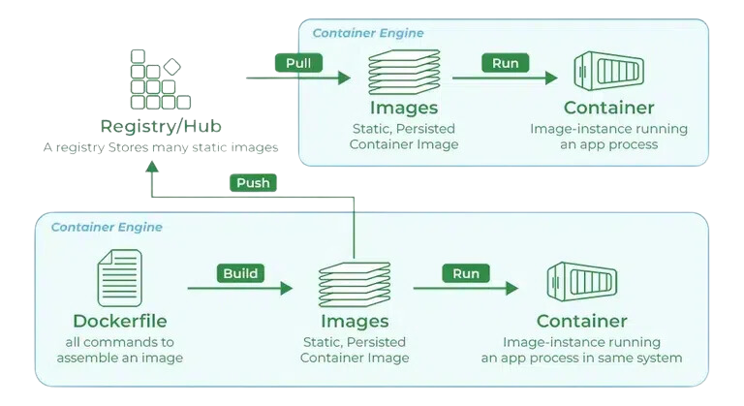
Core Concepts
2. Docker Images, Dockerfiles, and Registries

Slide 14
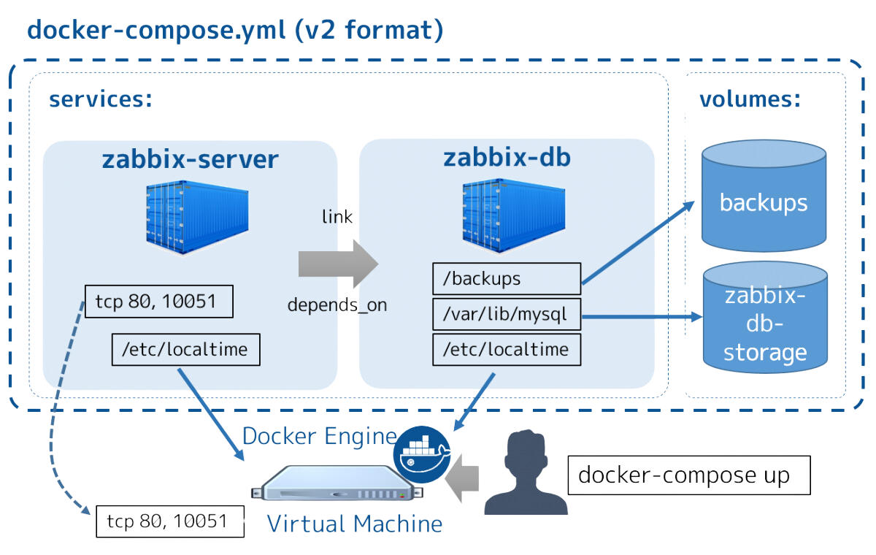
Core Concepts
3. Docker Compose

Slide 15
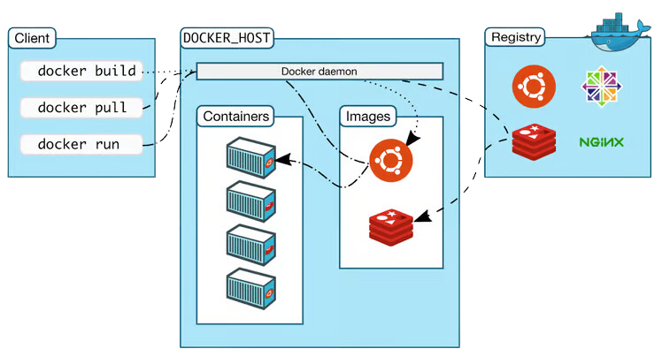
How Docker Works ?

Slide 16
How Docker Works ?
1. Building Containers:
A Docker container is created from a Docker image.
Use a Dockerfile to define the build process.
FROM python:3.8-slim COPY app.py /app.py CMD ["python", "app.py"]
Build the image using the command:
docker build -t myapp

Slide 17
How Docker Works ?
2. Shipping Containers:
Once built, the image can be pushed to a registry (e.g., Docker Hub).
docker push username/myapp
Once built, the image can be pulled from a registry (e.g., Docker Hub).
docker pull username/myapp

Slide 18
How Docker Works ?
3. Running Containers:
docker run -d -p 8080:80 myapp
Containers are created and run from images.
-d: Run in detached mode.
-p 8080:80: Map container port 80 to host port 8080.

Slide 19
Docker Architecture
Docker uses a client-server architecture. The docker client talks to the Docker daemon, which used to building, running, and distributing the Docker containers. The Docker client and daemon communicate using a REST API, over UNIX sockets, or a network interface.

Slide 20
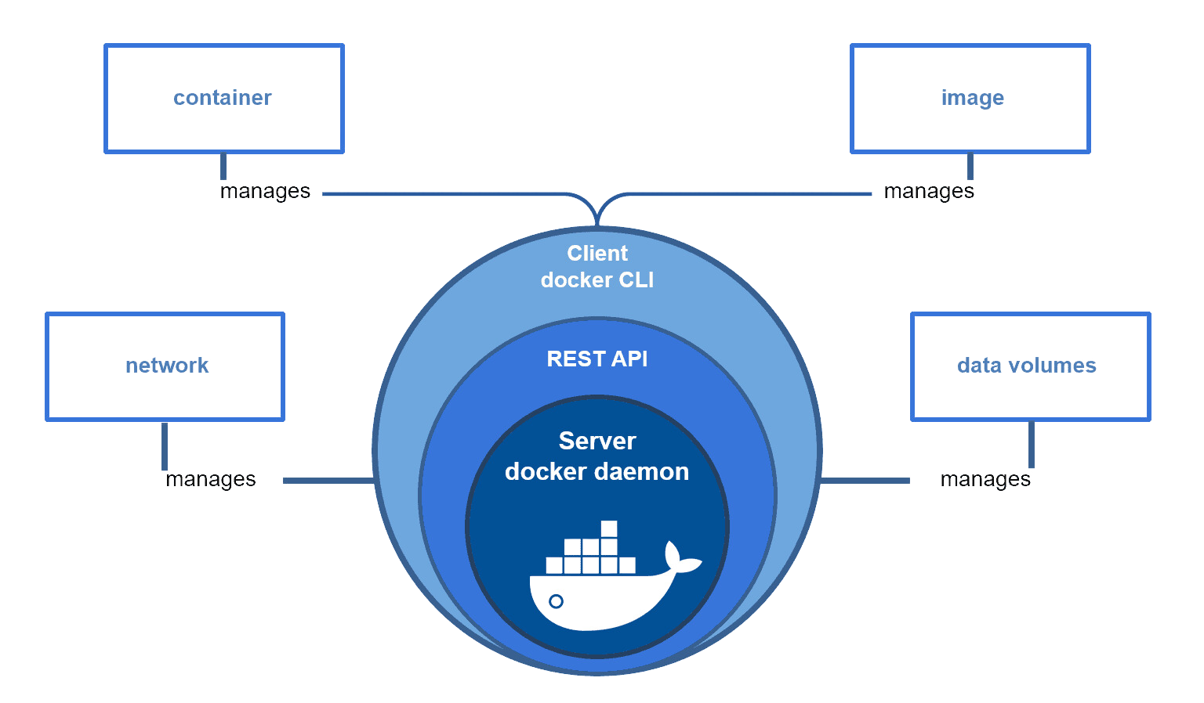
Docker Architecture

Slide 21
Docker Architecture
a) Docker Daemon: listens to Docker API requests and manages Docker objects such as images, containers, networks and volumes.
b) Docker Clients: With the help of Docker Clients, users can interact with Docker. Docker client provides a command-line interface (CLI) that allows users to run, and stop application commands to a Docker daemon.
c) Docker Host: provides a complete environment to execute and run applications. It comprises of the Docker daemon, Images, Containers, Networks, and Storage.

Slide 22
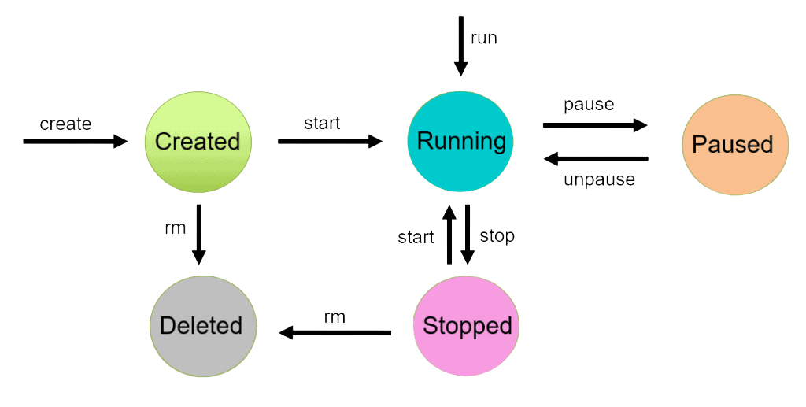
Docker Container Lifecycle Management

Slide 23
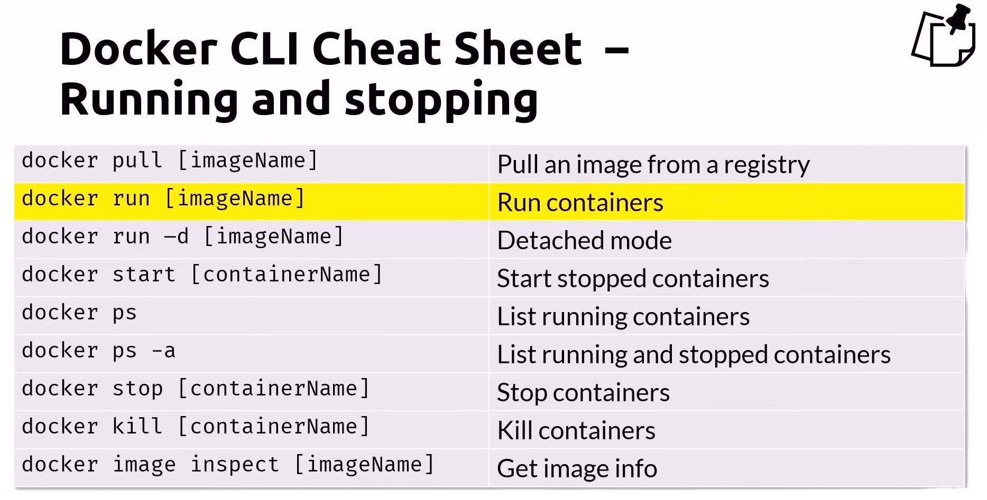
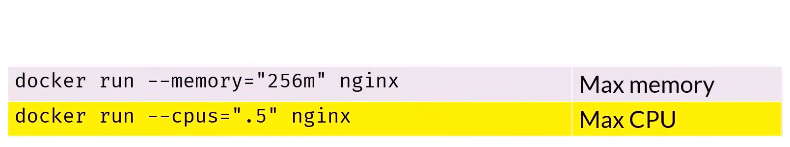
DOCKER CLI CHEAT SHEET

Slide 24
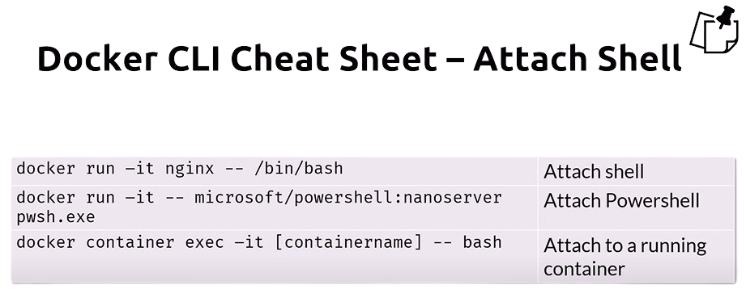
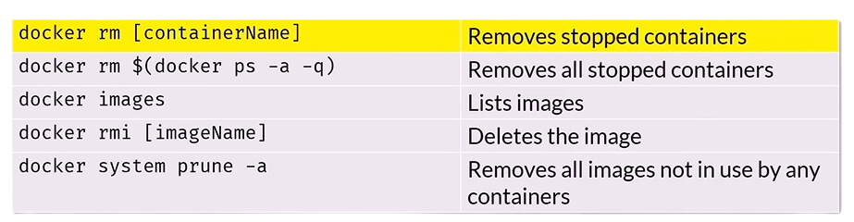
DOCKER CLI CHEAT SHEET

Slide 25
DOCKER CLI CHEAT SHEET

Slide 26
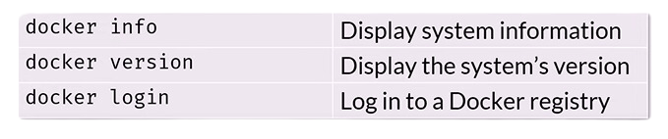
DOCKER CLI CHEAT SHEET

Slide 27
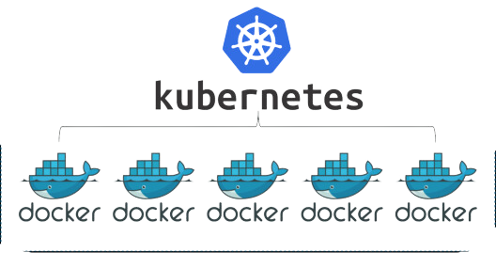
What is Kubernetes?
Kubernetes (often abbreviated as K8s) is an open-source platform designed to manage and orchestrate containers at scale. It automates the deployment, scaling, and management of containerized applications, making it easier to run applications reliably in complex, distributed environments.

Slide 28
Why is Kubernetes Needed When Docker Exists?
While Docker is excellent for creating and running individual containers, managing multiple containers across multiple servers quickly becomes challenging. Here's why Kubernetes is essential:
1. Managing at Scale:
Docker alone doesn’t provide tools for managing hundreds or thousands of containers across multiple servers.
Kubernetes automates container orchestration, ensuring applications run reliably even as the scale increases.

Slide 29
Why is Kubernetes Needed When Docker Exists?
2. High Availability and Resilience:
Docker cannot automatically restart containers if they fail, handle node failures, or distribute load between containers.
Kubernetes provides self-healing, automatically restarting or relocating containers to maintain system health.
3. Load Balancing and Traffic Distribution:
Kubernetes can efficiently route traffic to the right containers based on demand and health checks, ensuring optimal performance.

Slide 30
Why is Kubernetes Needed When Docker Exists?
4. Automation and Declarative Configuration:
With Kubernetes, you define the desired state of your application (e.g., number of replicas, resource limits), and it ensures the actual state matches the desired state.
5. Multi-Host Clusters:
Docker manages containers on a single host, while Kubernetes works across multiple machines, creating a unified cluster.

Slide 31
Role of Kubernetes in Orchestrating Containerized Applications
1. Deploying Applications:
Kubernetes automates the deployment process by running containers across nodes in a cluster.
It ensures the right number of replicas are running as specified in the configuration.
2. Scaling Applications:
Kubernetes can automatically scale applications up or down based on metrics such as CPU usage or incoming traffic.
This ensures efficient resource usage and cost savings.

Slide 32
Role of Kubernetes in Orchestrating Containerized Applications
3. Self-Healing:
Monitors container health and replaces failed containers automatically.
Ensures the application remains available even during failures.
4. Load Balancing:
Distributes incoming traffic across multiple containers to ensure no single container is overwhelmed.
Uses services to expose containers to the outside world reliably.

Slide 33
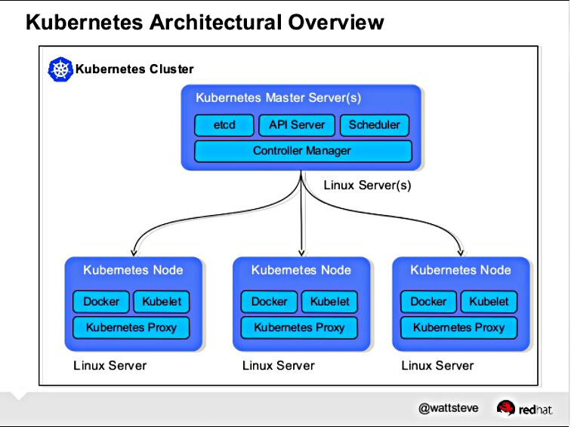
Core Concepts
1. Cluster: Master and Nodes

Slide 34
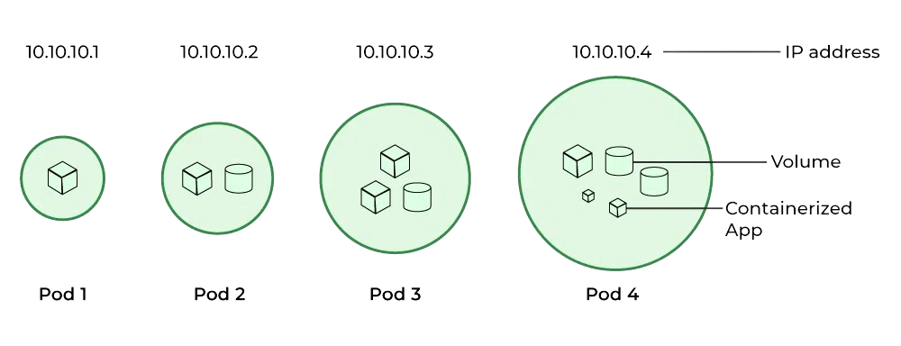
Core Concepts
2. Pods: The Smallest Deployable Unit

Slide 35
Core Concepts
3. Services: Exposing and Communicating Between Pods
A service provides a stable, permanent endpoint for accessing a group of pods.
Types of services:
ClusterIP: Internal communication within the cluster.
NodePort: Exposes the service to external traffic via a port on the node.
LoadBalancer: Distributes traffic across pods, typically in cloud environments.
Services allow pods to communicate reliably, even if the underlying pods change or restart.

Slide 36
Docker Swarm vs. Kubernetes
Docker Swarm and Kubernetes are both container orchestration tools, but they differ significantly in complexity and capabilities. Docker Swarm is lightweight, easy to set up, and ideal for smaller-scale projects, offering basic features like service discovery, load balancing, and manual scaling. In contrast, Kubernetes is a more robust and comprehensive platform, designed for enterprise-level workloads, with advanced features such as automated scaling, self-healing, rolling updates with rollbacks, and support for complex networking and persistent storage. While Docker Swarm excels in simplicity and is tightly integrated with Docker, Kubernetes provides greater flexibility, extensive third-party integrations, and a larger community, making it the go-to choice for managing large, complex, and distributed containerized applications.

Slide 37
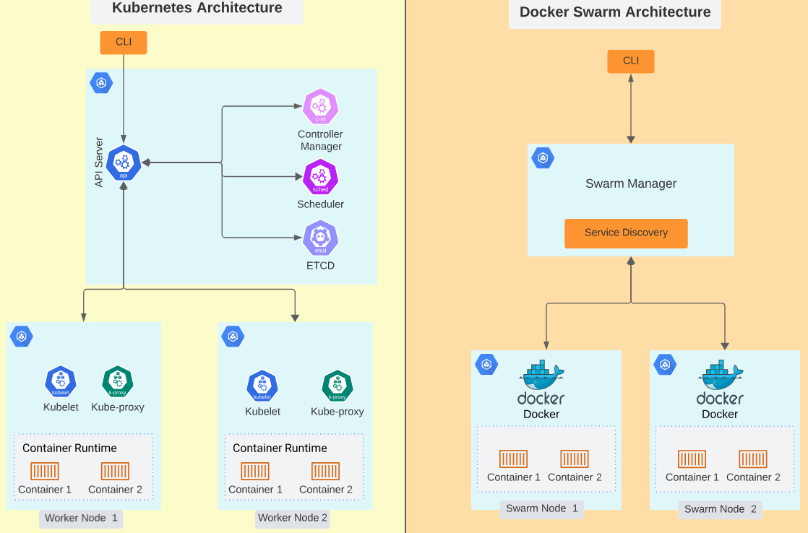
Docker Swarm vs. Kubernetes

Slide 38
It’s Time To Practice

Slide 39
Installation Docker
See My Pdfs Guidlines you gonna find them and all ressources on my github

Slide 40
Thank
you!
Do you have any questions?
Presented By Aymeni

